Slide 1
Conceptual Models
Slides: Dr. Richard Fujimoto
References:
Robinson, “Conceptual Modeling for Simulation,” Winter Simulation Conference, 2013.
Birta and Arbez, ch 4.

Slide 2
Outline
Introduction to Conceptual Models
Conceptual Model Elements
Entities
Activities
Queueing Networks

Slide 3
Modeling & Simulation Process: Conceptual Model
Representation of a system using some type of formalism
Examples: queueing networks, petri nets, cellular automata, differential eqs

Slide 4
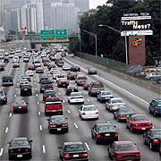

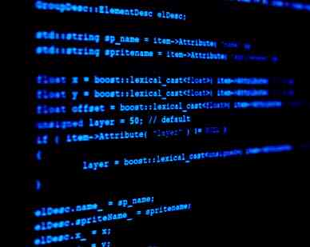
Conceptual Models
System Under Investigation (SUI)
Conceptual Model
Simulation Program

Slide 5
Conceptual Model
“… a non-software specific description of the computer simulation model (that will be, is, or has been developed), describing the objectives, inputs, outputs, content, assumptions and simplifications of the model.” [Robinson]
Distinct from simulation software
Addresses the question of what to include in the model and what to omit
Q: Is more detail better?

Slide 6
Level of Detail
high detail
Increased Detail:
Greater perceived credibility (and better defensibility)
Higher development cost
Longer development time
Longer execution time
Greater data requirements
Accuracy?
Low detail
Level of detail

Slide 7
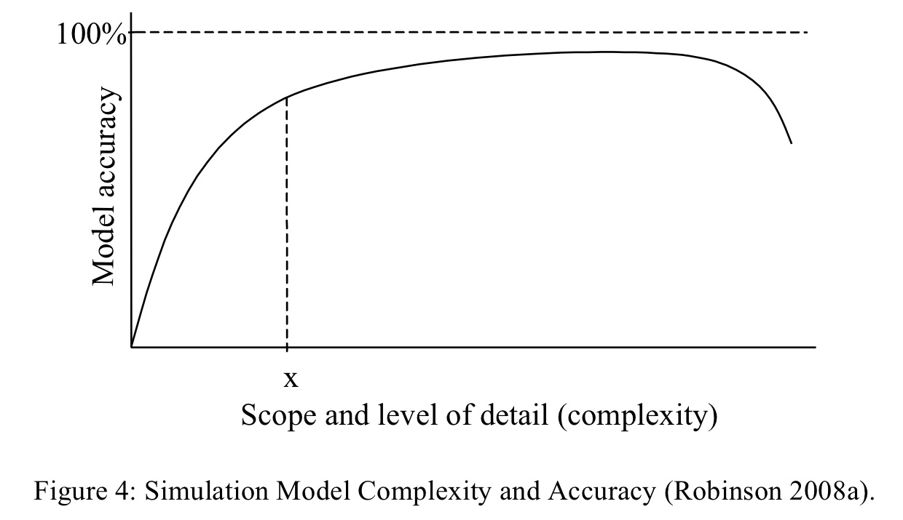
Detail vs. Accuracy
Errors due to model inaccuracies and lack of data
diminishing returns
From Robinson, “Conceptual Modeling for Simulation,” Winter Simulation Conference, 2013.
Myth: Increased detail leads to greater accuracy

Slide 8
Conceptual Model: Issues
The decision of what to leave out impacts the model along several dimensions:
Validity: produce sufficiently accurate results
Credibility: believed by the clients using results from the simulation study
Feasibility: Able to be built within the time and cost constraints of the study
Usefulness: sufficiently easy to use, flexible, fast execution

Slide 9
Conceptual Modeling
“… a non-software specific description of the computer simulation model (that will be, is, or has been developed), describing the objectives, inputs, outputs, content, assumptions and simplifications of the model.” [Robinson]
Assumptions: based on beliefs concerning the model; necessitated by lack of data or other information
Objectives: questions to be answered
Conceptual Model
Development
Inputs: independent variables varied during experimentation
Content: describes model entities and their behaviors (activities)
Simplifications: decisions to simplify model, e.g., to reduce development time
Outputs: metrics obtained from the model

Slide 10
Outline
Introduction to Conceptual Models
Conceptual Model Elements
Entities
Activities
Queueing Networks

Slide 11
Conceptual Models: An Example Activity Based Conceptual Model (ABCMod)
Activity Based Conceptual Model = < Θ, Ω, Φ >
Consumer Entity Classes (Θ)
Server Entity Classes (Ω)
Activities (Φ)
Attributes
Property
Path
Elapsed Time
Activity Types
Activity
Triggered Activity
Pre-emption
Interruption
Extended Activity
Extended Trigger Activity
Aggregate Entities
Resource Entities
Attributes
Queue Entities
Group Entities
Attributes
Attributes

Slide 12
Conceptual Model
Two parts
Entities: components making up the model
Events and Activities: description of the behaviors and actions of entities in the model

Slide 13
Entities
Components that populate space encompassed by SUI
Must recognize that model exists within a larger universe
Exogenous: components from the environment that are external to the SUI but influence the SUI
Arrival of ships in port
Roadway surface when evaluating car suspension
Endogenous: interacting components internal to the SUI; they fall into distinct classes:
Consumer: customers, messages, orders, vehicles, manufactured widgets, shipments, predators, bacteria, pollutants, forces
Resources: servers (in banks, gas stations, restaurants, call-centres), transport services (cranes, trucks, tugboats) or health services (ambulances, operating rooms, doctors/nurses)
Aggregates: queues, groups

Slide 14
Examples of Entities
System Under Investigation (SUI) | Consumer Entities | Resource Entities | Aggregated Entities
Gas Station | Cars, trucks | Pumps, Attendants | Queue of cars at each pump
Hospital Emergency Room | Patients | Doctors Nurses Examination rooms | Waiting room queue Critical patient queue Patients in examination rooms
Ecological System | Predator population Prey population

Slide 15

Problem Description
Consider two one-lane roads that meet at an intersection. There is a stop sign in each direction. For each direction, determine the average time a vehicle must wait at the stop sign.
Assumptions
One vehicle can use intersection at a time
Road has unlimited capacity to hold vehicles
Vehicles do not turn

Slide 16
Queueing Models
Queueing models are a natural abstraction for modeling systems like these that include
Customers competing to use a limited resource
Customers must wait (queue) to use the resource
Service discipline (e.g., first-come-first-serve)
Primary metrics of interest have to do with waiting time, resource utilization, throughput (number of vehicles passing through intersection per unit time)
Details of customer attributes (what the driver is doing or the exact location while waiting) are not important
Typical applications
Manufacturing, supply chains
Transportation systems
Service centers (e.g., retail stores, hospitals, call centers)
Communication networks
Computer systems

Slide 17
Elements of a Queueing Model (Entities)
Server
queue
Customers (jobs)
Server: serial (one at a time) reusable resource
Often assume service times for successive customers are independent and identically distributed (iid)
Probability distribution for service time
Customers: use resource, one at a time
Arrival process must be specified
Often assume interarrival time of customers are independent, identically distributed (probability distribution for interarrival time)
Queue
Holds customers waiting to use server
Finite vs. unlimited capacity
Service discipline (first-come-first-serve, last-in-first-out, priority, etc.)

Slide 18
Queueing Model
WB queue
WB vehicles
server
(intersection)
WB vehicles
NB queue
NB vehicles
NB vehicles
Two queues (westbound, northbound traffic)
One server (intersection)

Slide 19
Discrete Event Simulation
Discrete event simulation: computer model for a system where changes in the state of the system occur at discrete points in simulation time.
Fundamental concepts:
system state (state variables)
state transitions (events)
each event has a timestamp indicating when it occurs
A DES computation can be viewed as a sequence of event computations, where each event computation is assigned a (simulation time) time stamp
Each event computation can
modify state variables
schedule new events

Slide 20
State Variables
Vehicles: one state variable per vehicle
Intersection: IS /* intersection state */
Queue for traffic in each direction (NBQ, WBQ)
occupied /* boolean, true if occupied by vehicle */
vehicle /* ID of vehicle (if any) in intersection */
direction /* direction this vehicle (if any) traveling */
Notation
IS.NBQ, IS.occupied, etc. refer to individual attributes (fields) of the intersection(IS) state variable

Slide 21
Events: Identify Changes in State
State variable change when
New vehicle arrives (either direction): Arrival event
Vehicle leaves intersection: Departure event
Next vehicle enters the intersection
Previous two events occur at the same time; can be combined into a single event
Events
NBArrival(v,IS): northbound vehicle v arrives at IS
WBArrival(v,IS): westbound vehicle v arrives at IS
NBDeparture(v,IS): departure of northbound vehicle at IS
WBDeparture(v,IS): departure of westbound vehicle at IS

Slide 22
Behavior: Activities
Arrival
v₃
Departure
v₃
events
Arrival
v₁
Departure
v₁
Arrival
v₂
Departure
v₂
v₃
v₂
Wait (v₃)
Service (v₃)
activities
v₁
Service (v₂)
Service (v₁)
simulation time
Activities characterize behavior of vehicles over time
Each activity begins and ends with an event

Slide 23
Activity Based Conceptual Model (ABCMod)
Activity Based Conceptual Model = < Θ, Ω, Φ >
Consumer Entity Classes (Θ)
Server Entity Classes (Ω)
Activities (Φ)
Attributes
Property
Path
Elapsed Time
Activity Types
Activity
Triggered Activity
Pre-emption
Interruption
Extended Activity
Extended Trigger Activity
Aggregate Entities
Resource Entities
Attributes
Queue Entities
Group Entities
Attributes
Attributes

Slide 24
Questions To Consider
What is the service time distribution?
Deterministic? Normal? Uniform [T_{min}, T_{max}]?
What is the arrival process? Interarrival time distribution?
Exponential?
How should finite queues be incorporated into the model?
How would one include vehicle turns in the model?
How would one extend the model to handle traffic signals?
Are the iid assumptions reasonable?

Slide 25
Summary
Conceptual modeling specifies what to include (and exclude) from the model
Informed by inputs, outputs, objectives
Constrained by time and cost to create and exercise the model
Leads to model assumptions and specifications
Includes a description of model entities and their behaviors (activities)
More an art than a science

Slide 26
Queueing Networks: Some useful properties (e.g., for verification and validation)

Slide 27
Kendall Notation: X/Y/Z Queue
X: Arrival Process (interarrival time distribution)
M: Markovian (exponentially)
D: Deterministic (fixed)
G: General distribution
Y: Service time distribution
Examples: M, D, G
Z: number of servers
Extensions specify capacity, size of customer population, queueing discipline
Example: M/M/1 queue
Known analytic solutions for properties such as average waiting time, queue length, throughput

Slide 28
Things You Should Know About Queues
Exponential distribution has the “memory-less property” – past history plays no role in predicting the future
Little’s law: N=λT
N=average number of customers in the system
λ=average arrival rate
T=average time spent in the system
Independent of arrival, service distribution
As the arrival rate approaches the service rate, the length of the queue and the waiting time grows without bound

Slide 29
M/M/1 Queue
T
Low utilization: small increase in utilization (workload) causes modest increase in delay
High utilization: as utilization approaches 1, small increase in workload causes large increase in delay
What if ρ>1 (e.g., in a simulation)?
1/μ
ρ
0
1
λ = arrival rate; μ = service rate; ρ = λ/μ = utilization
1/λ = avg interarrival time; 1/μ = avg service time
avg. # in system N = ρ / (1- ρ)
avg. # waiting = ρ N
avg. time spent in system T = (1/μ) / (1-ρ)
avg time spent waiting = ρ T

